Slide 1
Miniature Satellite

Slide 2
Abstract
The proposed project is a miniature satellite. The main purpose of this satellite is to measure the pressure using the BMP180 sensor (barometer), temperature using the MPU6050 , UV radiation levels using the GYML8511 and gas compositions at every level or layer of the atmosphere right up till the point of minimum gravity.
The components such as the sensors and the Arduino pro mini(the microcontroller) will be held within a 4/4 cm 3-D printed nylon fiber cube which will act as the primary exoskeleton of the satellite which will protect from harsh weather conditions and any sort of impact.
The data recorded by these sensors will be stored in a 16GB SD card and can be retrieved when ever the satellite lands on the surface. The satellite will use a MPU6050, this device will act as a triple axis accelerometer and a gyroscope.
This sensor will help measure the trajectory and record the projectile motion of the satellite as it rises and descends.
Using the multiple linear regression feature of machine learning we can predict the trajectory and nature of motion of other similar objects that may enter our orbit and fall.
This satellite is extremely light making it easy to deploy and it’s components a.

Slide 3
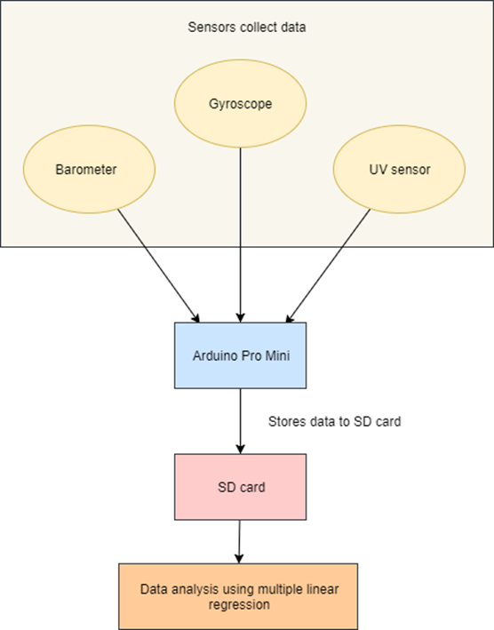
System Architecture

Slide 4
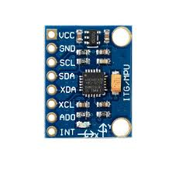
MODULE-
MODULE 1-
GYROSCOPE
The MPU 6050 is a 6 DOF (degrees of freedom) or a six-axis IMU sensor, which means that it gives six values as output: three values from the accelerometer and three from the gyroscope. The MPU 6050 is a sensor based on MEMS (micro electro mechanical systems) technology.

Slide 5
OUTPUT-

Slide 6
MODULE 2-
BARMOETER
It can widely measure pressure ranging from 300 mbar to 1200 mbar, with a super high accuracy of 0.01mbar(0.1m) in ultra-high resolution mode. The chip only accepts 1.8V to 3.6V input voltage. However, with the outer circuit on the pcb added, this module becomes compatible with 3.3V and 5V. Therefore, it can be used with an Arduino. It is designed to be connected directly to a microcontroller via the I2C bus.

Slide 7

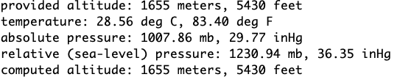
OUTPUT-

Slide 8
MODULE 3-
SD CARD
Used for read and write operation for the data from the arduino.

Slide 9
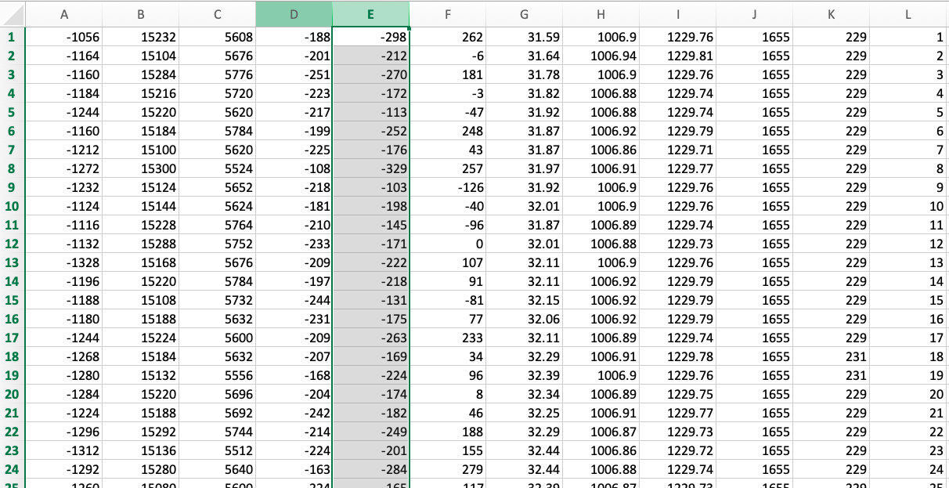
OUTPUT-

Slide 10
MODULE-4
UV SENSOR
UV phototubes are radiation-sensitive sensors that are used for monitoring UV air treatments, UV water treatments, and solar irradiance. Light sensors are general-purpose devices for measuring the intensity of incident light. UV spectrum sensors are charge-coupled devices (CCD) that are used in scientific photography.

Slide 11
OUTPUT-

Slide 12
MODULE-5
GPS
Gives the latitude and longitude of the satellite.

Slide 13
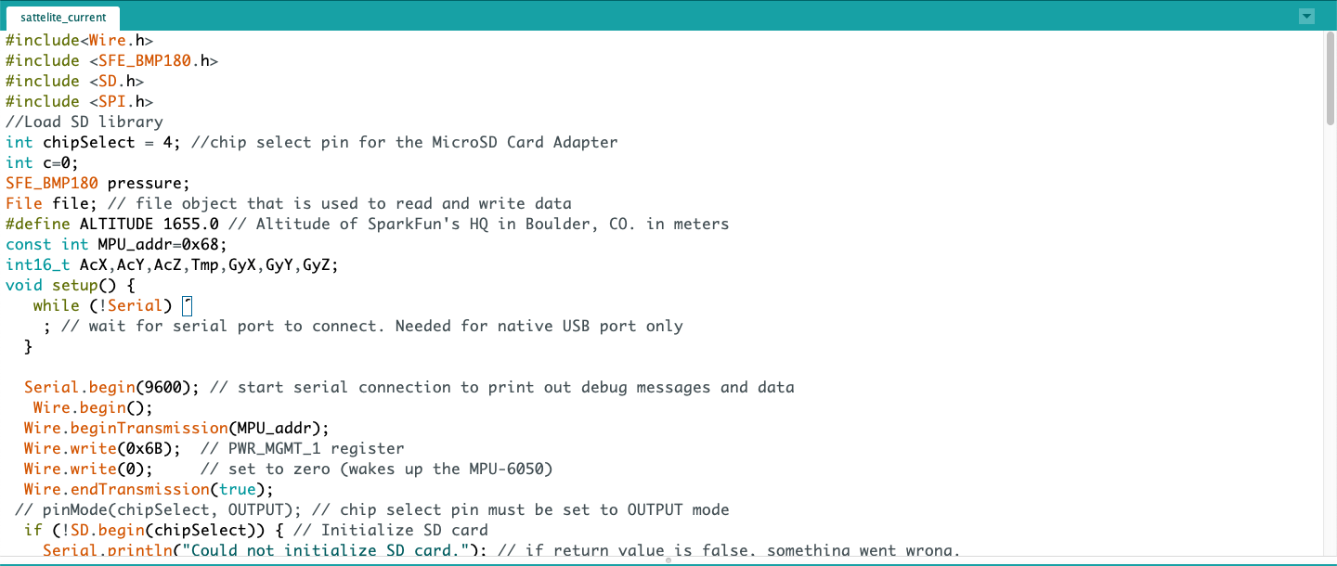
CODE-

Slide 14
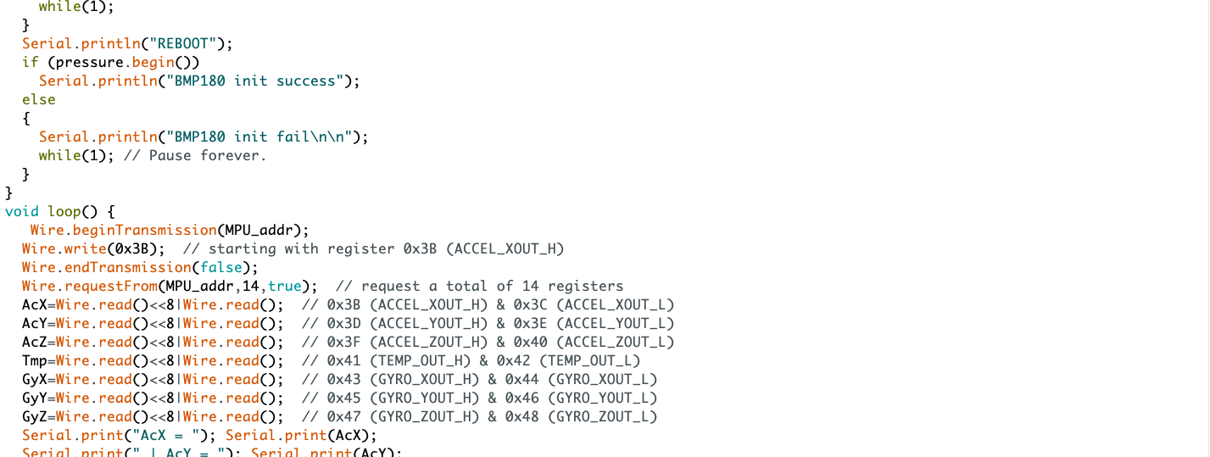

Slide 15
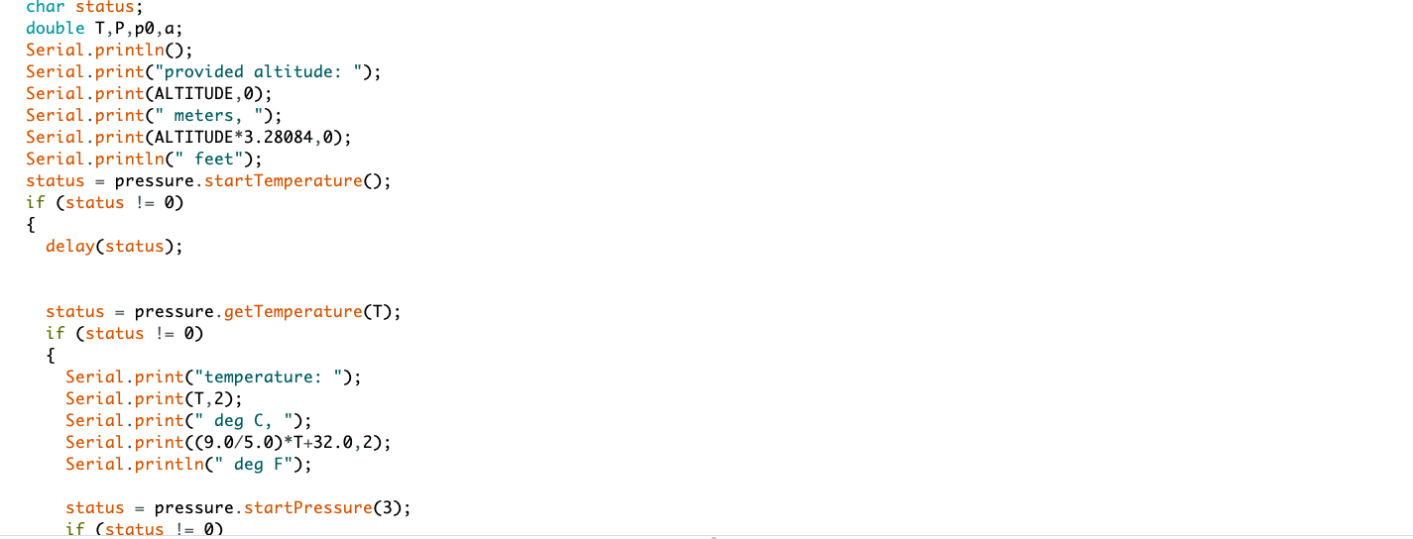

Slide 16
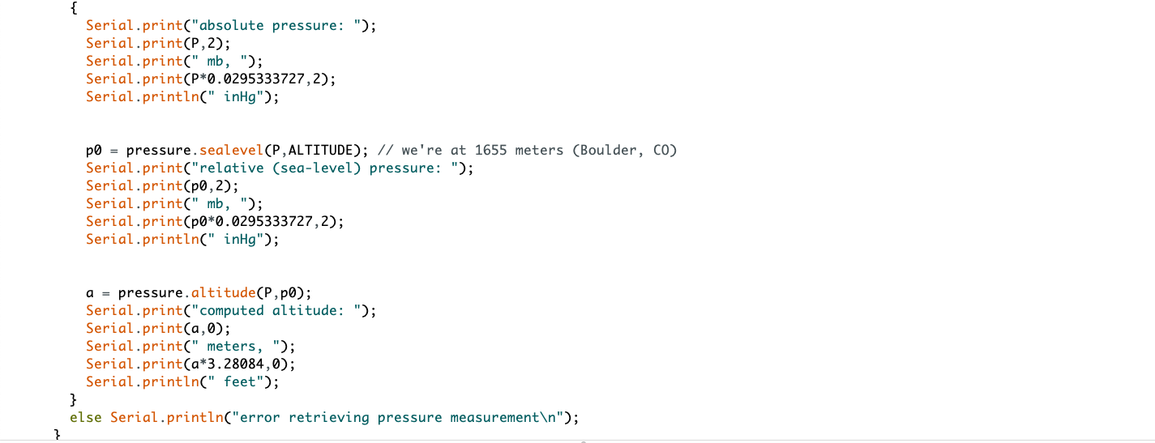

Slide 17
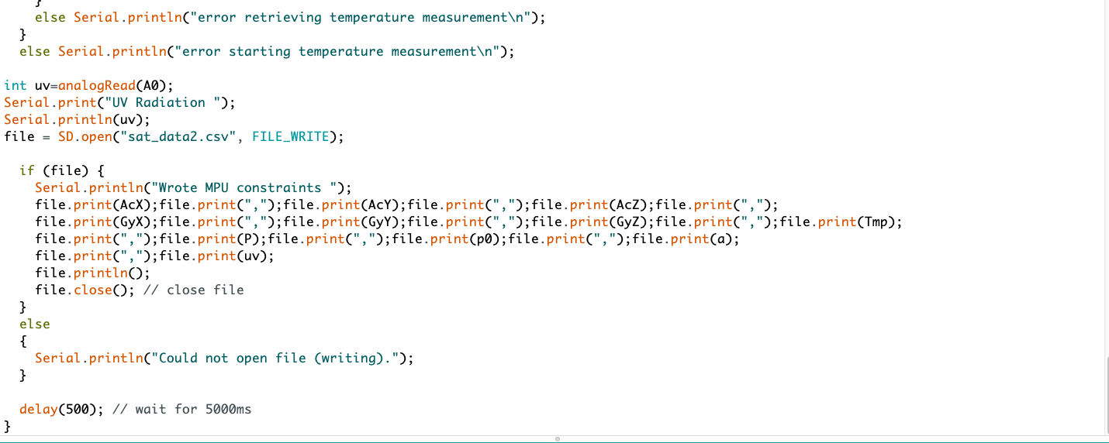

Slide 18
Existing System
A lot of satellites exist within the Karman line (the edge of our atmosphere) which are used for multiple purpose such as research and monitoring. Most of these satellites are quite large , hence making it difficult and expensive to deploy them. Satellite that exist within the Karman line are usually referred to as microgravity satellite, which are mostly used for research purposes. Example : Shijian -10, which carries 20 experiments covering fluid physics, material science and the effects of radiation and microgravity on various biological system.
MINIATURE SATELLITE :
Jai hind 1s :
This particular satellite was developed by the students of Hindustan University. The internal system of the satellite is held within a 4 cm wide cube. The main purpose of this satellite is to measure atmospheric parameters such as temperature, pressure and gas composition.

Slide 19
Proposed System
The proposed system is a miniature microgravity satellite.
The main purpose of this satellite is to measure the pressure using the BMP180 sensor (barometer), temperature using the MPU6050 , UV radiation levels using the GYML8511 and gas compositions at every level or layer of the atmosphere right up till the point of minimum gravity.
The components such as the sensors and the Arduino pro mini(the microcontroller) will be held within a 4/4 cm 3-D printed nylon fiber cube which will act as the primary exoskeleton of the satellite which will protect from harsh weather conditions and any sort of impact.
The MPU6050 will act as a gyroscope and will record the trajectory of the satellite along with temperature and triple axes acceleration.

Slide 20
Proposed System
The pressure will be measured using the BMP180 sensor (barometer),
The satellite will record UV radiation levels using the GYML8511.
The satellite will store the recorded data within a SD card
The satellite uses Machine learning with the help of Multiple Linear Regression Algorithm for analyzing and predicting similar data.
The Multiple Linear Regression Algorithm

